Slide 1
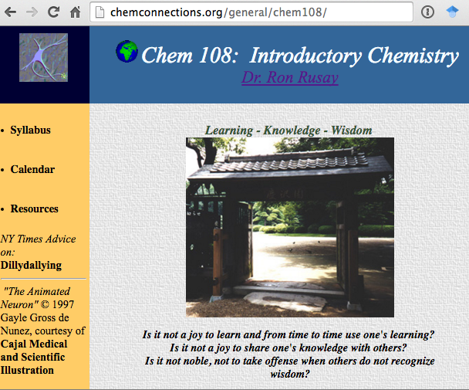
Chem 108
Introductory Chemistry
http://chemconnections.org/general/chem108/
Class: MW 11:10-12:35 (PS 277)
Discussion/Lab:
12:45-3:55 M (PS 221) sec. 2341
12:45-3:55 W (PS 221) sec. 2343
Dr. Ron Rusay
E-mail: rrusay@chemconnections.org (preferred) or rrusay@dvc.edu
Please sign the roster next to your name on the clipboard that is at the front of lab.
If your name does not appear, please stand at the back of the lab.

Slide 2
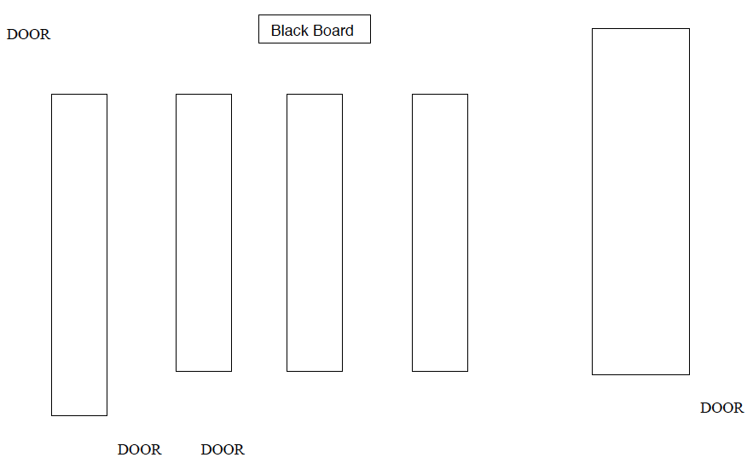
Chem 108
Lab Map
FRONT
25
24
17
16
9
8
1
26
23
18
15
10
7
2
27
22
19
14
11
6
3
28
21
20
13
12
5
4
BACK
Class size is limited to a maximum of 28 due to lab safety. Anyone on the roster who is absent today will be placed at the end of the wait list and any new sign-ins. 28 lab drawers will be assigned today to the first 28 signed in on today’s roster. If needed, add codes will be provided today; DO NOT leave until you have seen Dr. R @ the end of lab. The codes are ONLY VALID for 48 hours.

Slide 3
Chem 108
Lab Map
FRONT
25
24
17
16
9
8
1
26
23
18
15
10
7
2
27
22
19
14
11
6
3
28
21
20
13
12
5
4
BACK
If you are on the roster & signed in, select one of the numbered lab stations in the above lab map and then move to that location. (1 per station)
Introduce yourself to one or more of the classmates around your station; Describe what other courses you are taking this semester to them and learn what your classmate(s) is (are) taking.

Slide 4
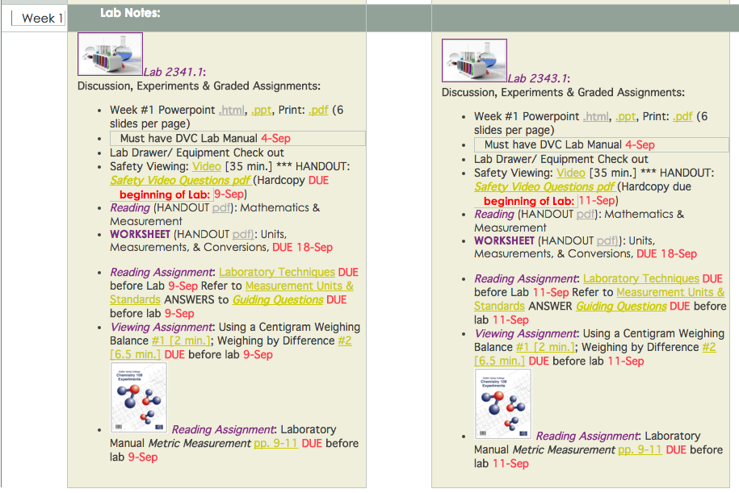
Chem 108: Lab
http://chemconnections.org/general/chem108/calendar-108-f19.html
Monday
Wednesday
Take out your smart phone or get a laptop from the front of the lab.
Open DVC wifi.
Connect to the Internet.
Go to:
http://chemconnections.org/general/chem108/
Click on Calendar
link
Refer to [Lab Notes: Week #1 Powerpoint link] for today’s lab.
Links for subsequent labs will be provided throughout the semester.

Slide 5
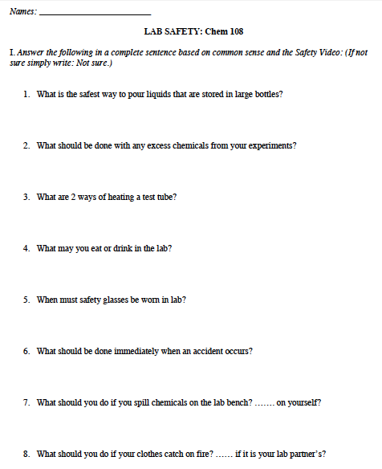
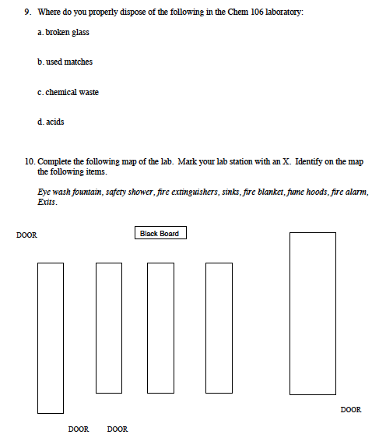
Doing: Lab Experiments
Safety
(Video & Handout)
http://chemconnections.org/general/chem108/Lab/Safety_focus_ques-18.pdf
Have map page signed by Dr. R. before leaving Lab today.
Completed handout due before beginning experiment.

Slide 6
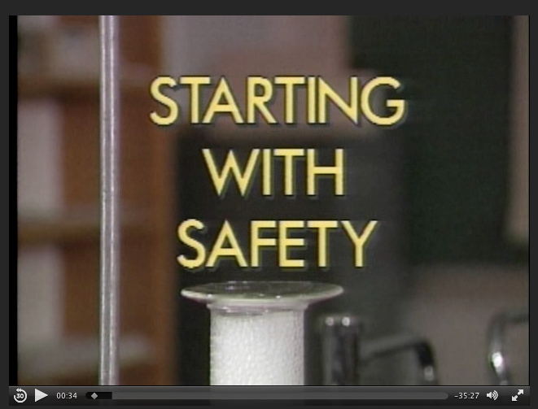
Doing: Lab Experiments
Safety
(Video & Handout)
http://chemconnections.org/general/movies/Safety_Video.mp4/Safety_focus_ques-17.pdf

Slide 7

Lab Drawer Check Out
Follow instructions

Slide 8
Lab Drawer Check Out
PURCHASE a copy of the Lab Manual @ the DVC Bookstore before the next lab.
If there are no copies on the shelf, ask at the service desk and they should re-stock for you.

Slide 9
Doing: Lab Experiments
Metric Measurement [Experiment #1: Week 3]
(Course/ Lab Manual pp. 9-11; pp. 12-15 [Report Form])
http://chemconnections.org/general/chem108/calendar-108-f19.html

Slide 10


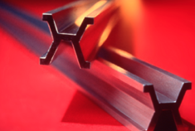
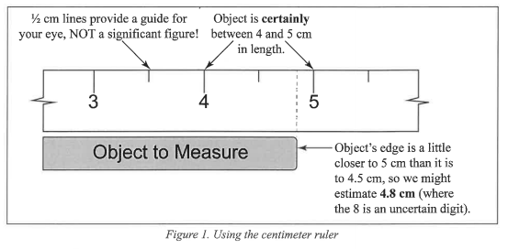
Doing: Lab Experiments
Metric Measurement [Experiment #1]
(Course/ Lab Manual pp. 9-11; pp. 12-15 [Report Form])

Slide 11
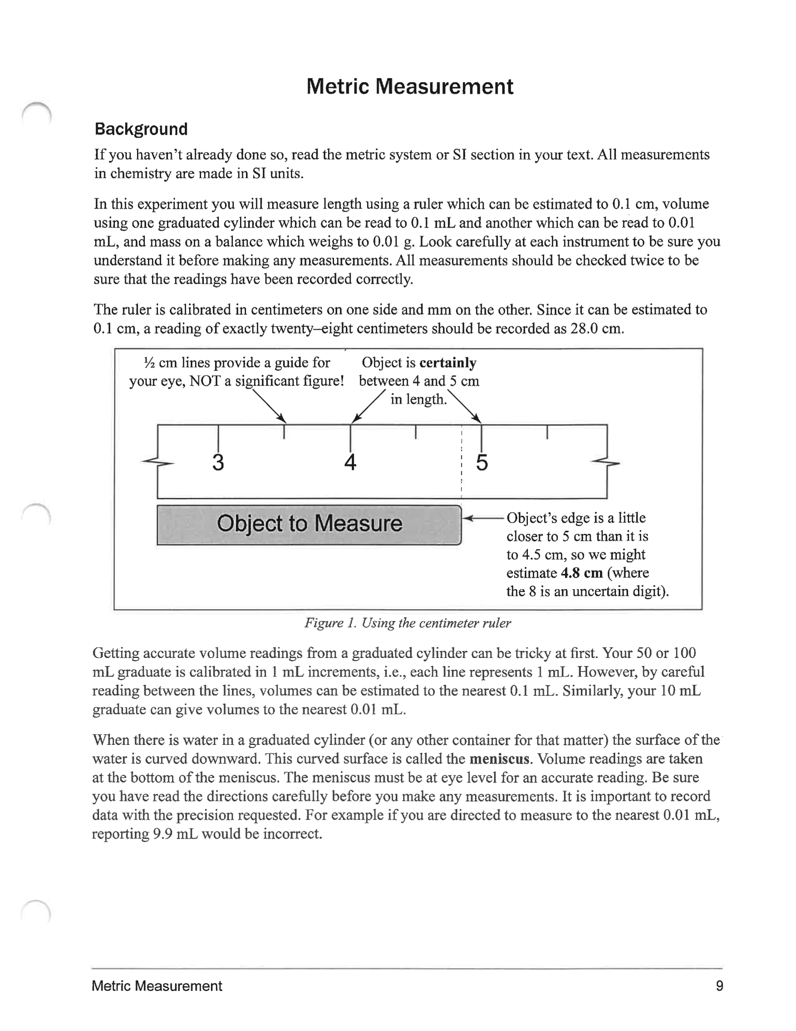
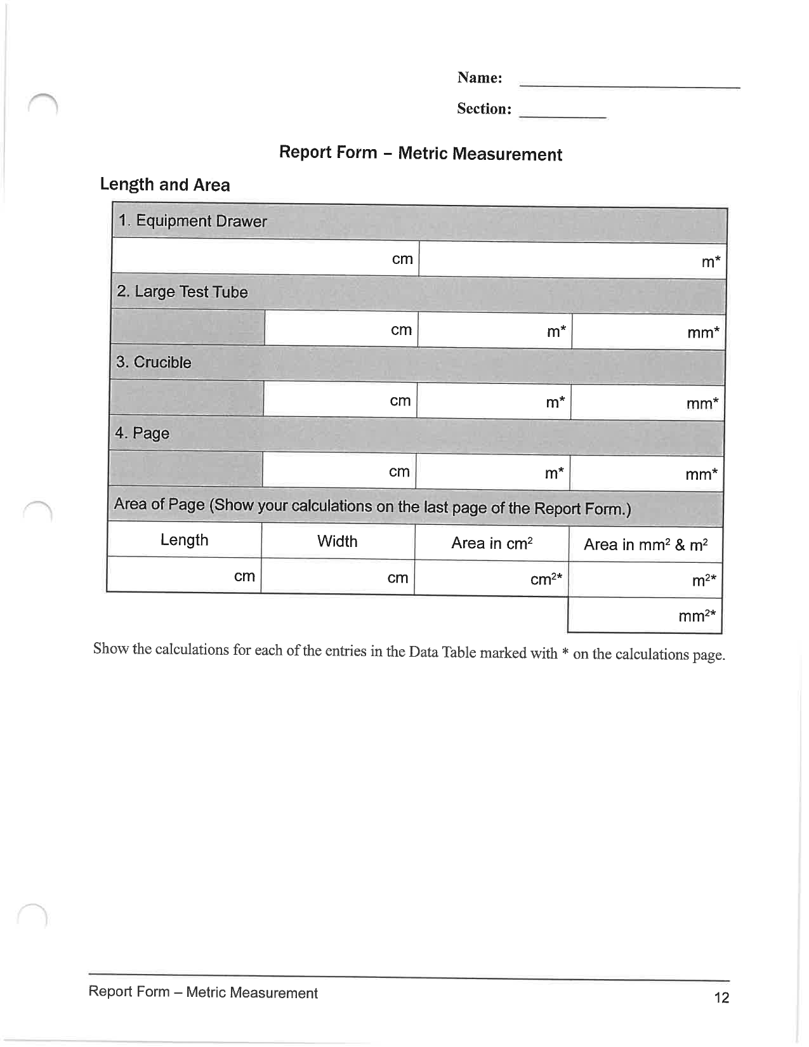
Doing: Lab Experiments
Metric Measurement [Experiment #1]
(Course/ Lab Manual pp. 9-11; pp. 12-15 [Report Form])
http://chemconnections.org/general/chem108/calendar-108-f19.html
Collaboration is encouraged, but individual record keeping and submissions are required.

Slide 12
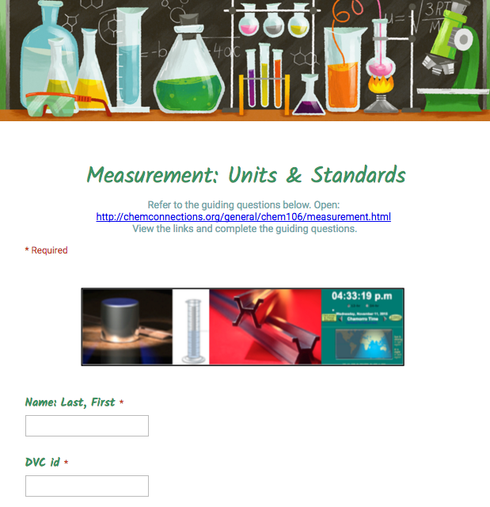
Doing: Lab Experiments (Submit before Lab)
Metric Measurement [Experiment #1]
Background & Preparation [Graded Guiding Questions]
http://chemconnections.org/general/chem108/Measurements.Units-Guide.html

Slide 13
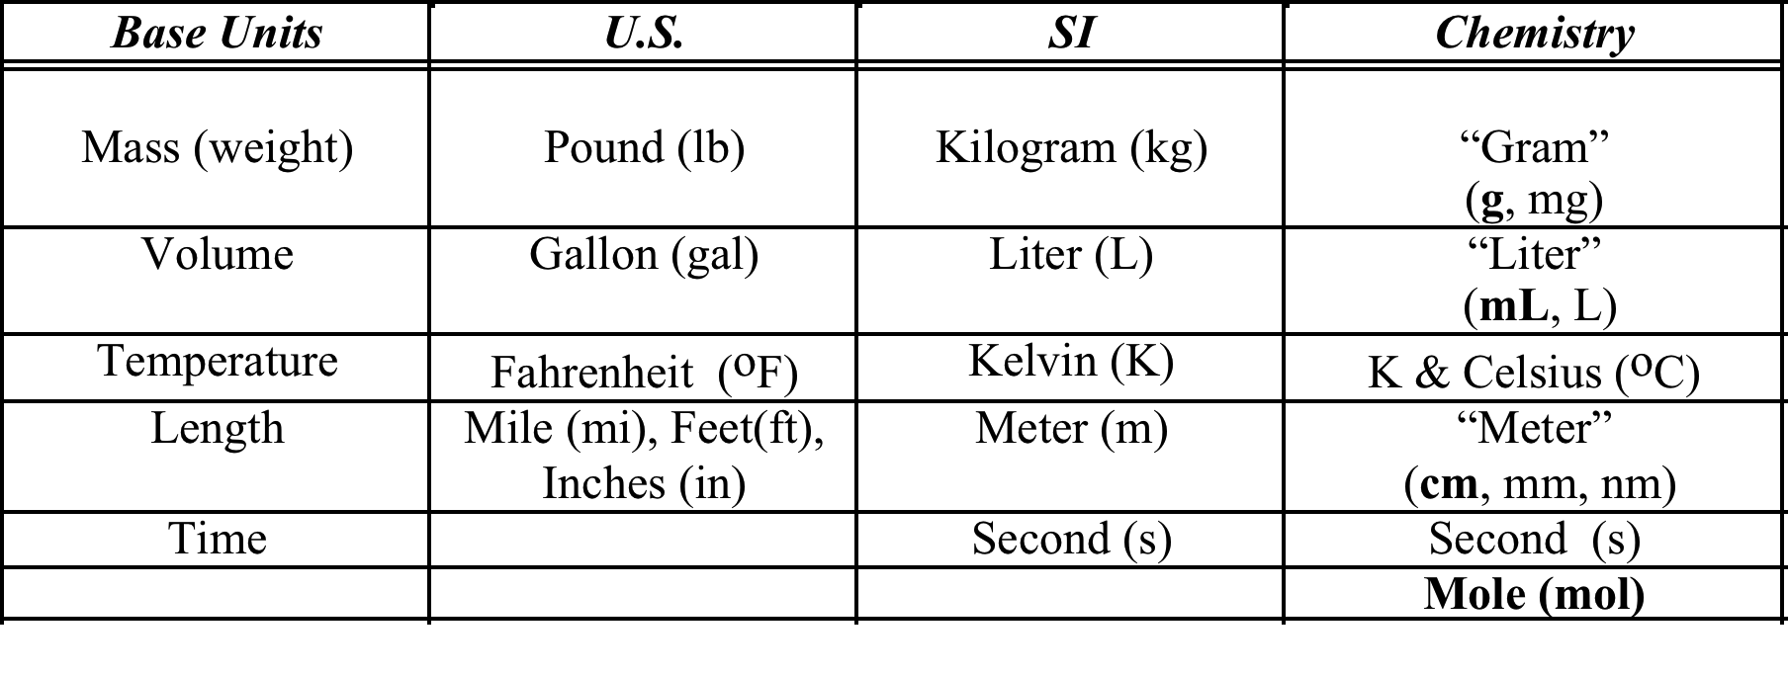

Units of Measurement
https://www.youtube.com/watch?v=7bUVjJWA6Vw
International SI units are based on the metric system, not the
British units commonly used in the U.S.

Slide 14
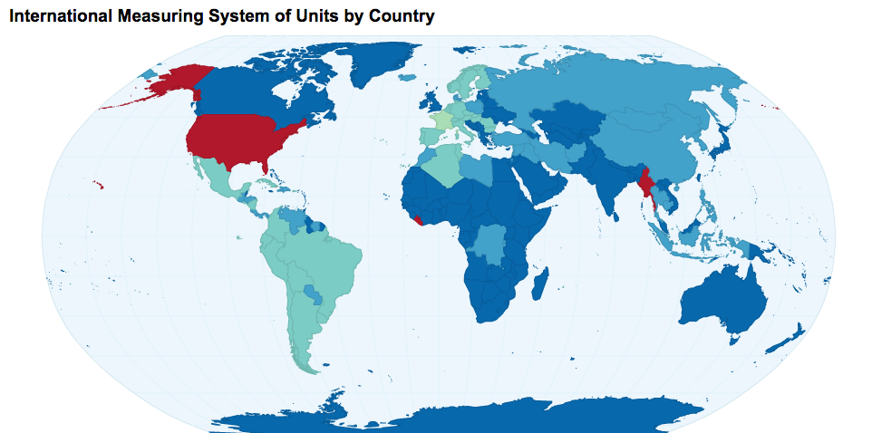
Countries using “British” Units in red
All other countries use the metric system.
Notes:
http://chartsbin.com/view/d12
Only three countries - Burma, Liberia, and the United States - have yet to adopt the International System of Units as their official system of measurement (weights and measures). Although use of the metric system has been sanctioned by law in the US since 1866, it has been slow in displacing the American adaptation of the British Imperial System known as the US Customary System. The US is the only industrialized nation that does not mainly use the metric system in its commercial and standards activities.
https://en.wikipedia.org/wiki/English_units

Slide 15
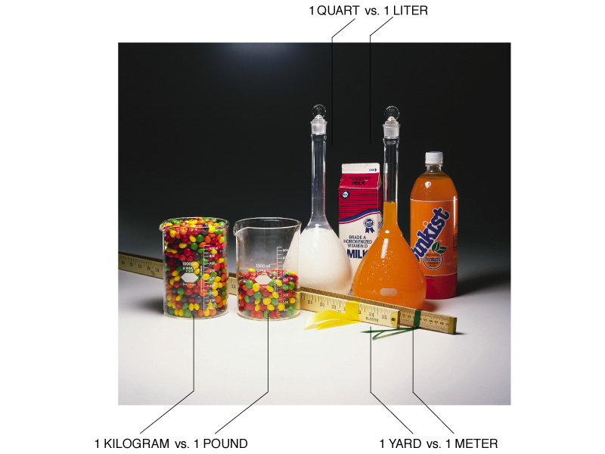
“British” : Metric Comparisons

Slide 16
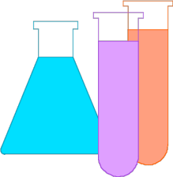
Measurement & Units
International SI units & common units in Chemistry
MASS (Chem 108: gram; SI: kg; other mg)
LENGTH (Chem 108: cm & mm; SI: m; other km)
TEMPERATURE (Celsius & Kelvin; SI: K)
VOLUME (Chem 108: mL; SI: Liter; other dL)
CHEMICAL AMOUNT: mole (mol); SI: (mol); other (mmol)
SI units are based on the metric system, not the
English units commonly used in the U.S.

Slide 17
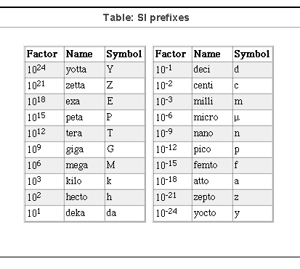
Shorthand Prefixes
Language describes scale (prefixes)
Hella is a prefix associated with Northern California: UC Davis, UC Berkeley, LBL, LLNL & adopted by Google (2010) & Wolfram Alpha (2011)
"hella-” = 10 ²⁷
Notes:
Diameter of the observable universe: 93 Gly or 8.8×10^26 m
George Smoot Nobel 2006 wrinkles in the universe
http://aether.lbl.gov/www/personnel/Smoot-bio.html
http://www2.lbl.gov/Publications/Nobel/
http://aether.lbl.gov/www/personnel/smoot/smoot-measure.html

Slide 18
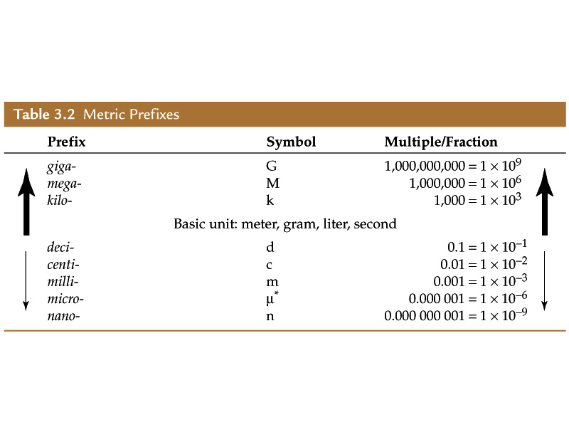
Commonly Used Prefixes in Chemistry

Slide 19
Measurement & Numbers
The Importance of Units
Measurement - quantitative observation consisting of 2 parts
  Part 1 - number
  Part 2 – unit
  Relates to the instrument
  (tool) used for the
  measurement.
  Examples:
  20.0 grams
  6.63 × 10⁻³⁴ joules / second
1 Joule (J):
The heat required to raise the temperature of 1 g of water by 0.24 K; 1 J = 0.24 calories.^{[6]}
The heat released as heat by a person at rest every 1/60 second (~17 ms); .^{[7]}
The kinetic energy of a 50 kg (110 lb) human moving at 0.43 mi/hr).
The amount of electricity required to light a 1 watt LED for 1 s.

Slide 20
Measurements & Numbers
Any number determined by any method of measurement: MUST ALWAYS INCLUDE the UNIT being measured.
Example: 20.0 grams
Short Hand expression translates the number to Scientific Notation
Example: 2.00 x 10¹ grams

Slide 21
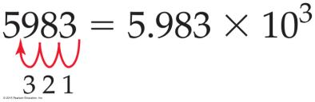
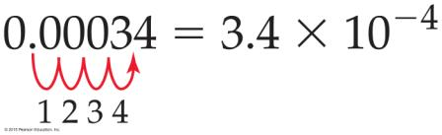
Converting a Number to Scientific Notation
units are not included in the examples
If the decimal point is moved to the left, the exponent is positive.
If the decimal point is moved to the right, the exponent is negative.

Slide 22
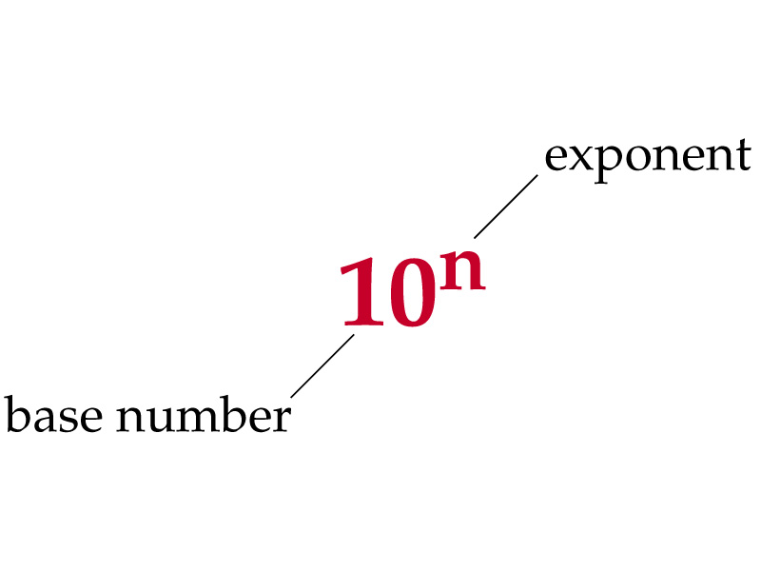
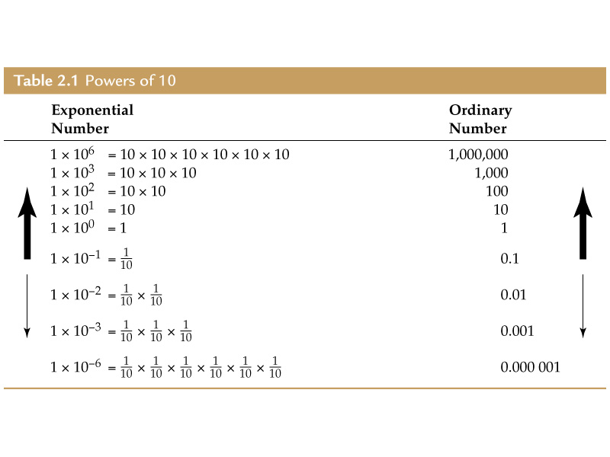
Powers of Ten:
Scale

Slide 23
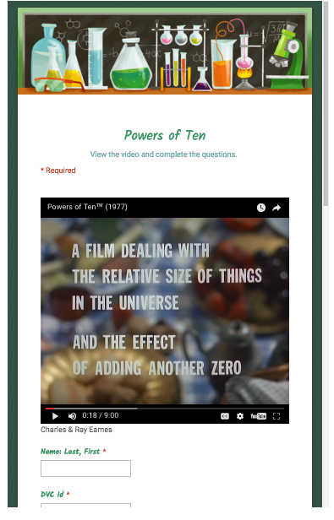
Hearing/Viewing: Guiding Questions (GQ)
Measurements & Relative Scale
http://chemconnections.org/general/chem108/Powers%20of%20Ten-Guide.html
https://www.youtube.com/watch?v=0fKBhvDjuy0
Answer all Guiding Questions on-line
Example: First GQ assignment
.
From the calendar links, submit responses on-line; graded weekly.

Slide 24
Scientific Notation & Mathematics
Short Hand expression:
Powers of Ten / Exponents of base Ten
Count decimal places: to left (+) and to the right (-)
Multiplication: add exponents
Division: subtract exponents
1,000,000,000 kg/m³ = 1 x 10 ⁹ kg/m³
0.00000018 kg/cm³ = 1.8 x 10⁻⁷ kg/cm³

Slide 25
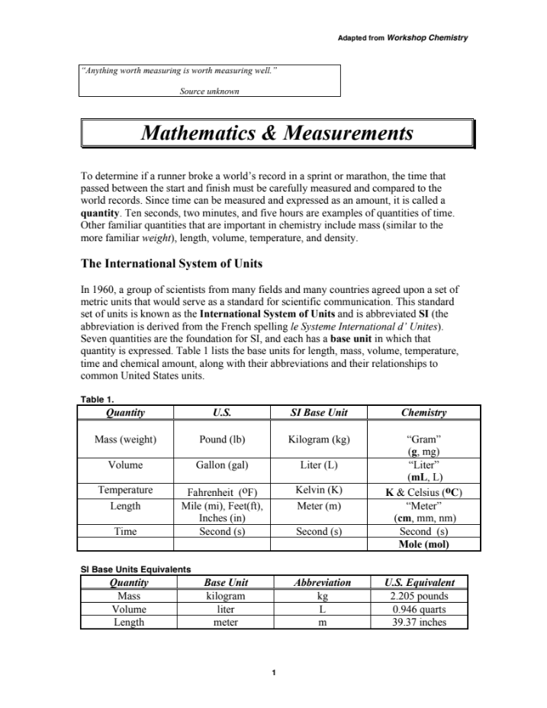
Doing: Lab Experiments (Read before Lab)
Metric Measurement [Experiment #1]
Background & Preparation [Reading Handout & Worksheet]
http://chemconnections.org/general/chem108/Math & Measurement-2018.pdf

Slide 26
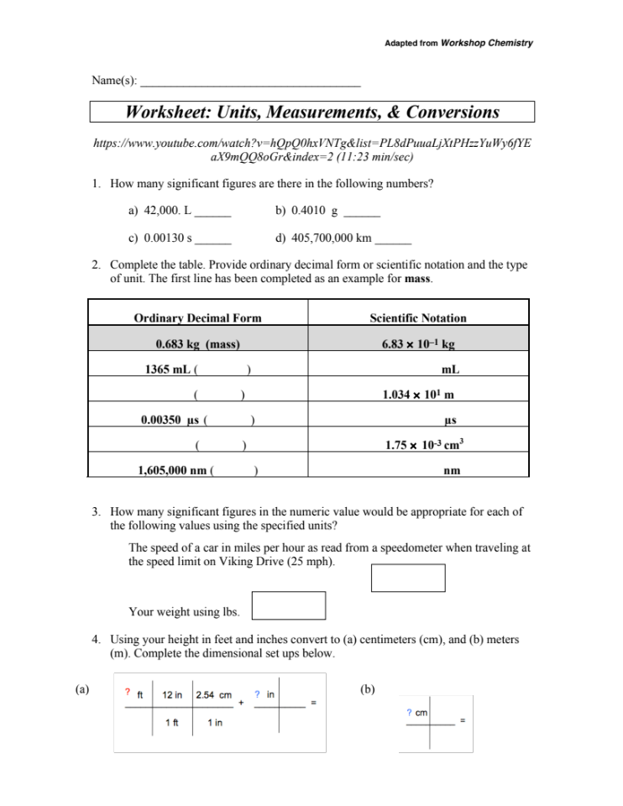
Doing: Lab Experiments (In lab)
Metric Measurement [Experiment #1]
Background & Preparation [Reading & Worksheet Handout]
http://chemconnections.org/general/chem108/Math & Measurements-WKS.f18.pdf

Slide 27
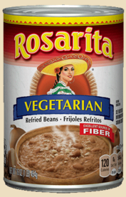

Dimensional Analysis
Conversion/Unit Factor Calculations
An average adult needs at least 150 grams (1.50 x 10² g) of carbohydrates in the diet each day. A can of vegetarian refried beans has 19 g of carbohydrate per serving. Each serving is 128 g of beans.
If your only dietary source of carbohydrate were vegetarian refried beans, how many pounds of beans would you need to eat today to satisfy your carbohydrate dietary needs?
g
Notes:
2.227791701 lbs
http://boards.straightdope.com/sdmb/showthread.php?t=643437

Slide 28
Dimensional Analysis
Conversion/Unit Factor Calculations
An average adult needs at least 150 grams (1.50 x 10² g) of carbohydrates in the diet each day. A can of vegetarian refried beans has 19 g of carbohydrate per serving. Each serving is 128 g of beans.
If your only dietary source of carbohydrate were vegetarian refried beans, how many pounds of beans would you need to eat today to satisfy your carbohydrate dietary needs?
g
Notes:
2.227791701 lbs
http://boards.straightdope.com/sdmb/showthread.php?t=643437

Slide 29
Dimensional Analysis
Conversion/Unit Factor Calculations
An average adult needs at least 150 grams (1.50 x 10² g) of carbohydrates in the diet each day. A can of vegetarian refried beans has 19 g of carbohydrate per serving. Each serving is 128 g of beans.
If your only dietary source of carbohydrate were vegetarian refried beans, how many pounds of beans would you need to eat today to satisfy your carbohydrate dietary needs?
g
Notes:
2.227791701 lbs
http://boards.straightdope.com/sdmb/showthread.php?t=643437

Slide 30
Dimensional Analysis
Conversion/Unit Factor Calculations
An average adult needs at least 150 grams (1.50 x 10² g) of carbohydrates in the diet each day. A can of vegetarian refried beans has 19 g of carbohydrate per serving. Each serving is 128 g of beans.
If your only dietary source of carbohydrate were vegetarian refried beans, how many pounds of beans would you need to eat today to satisfy your carbohydrate dietary needs?
g
Notes:
2.227791701 lbs
http://boards.straightdope.com/sdmb/showthread.php?t=643437

Slide 31
Dimensional Analysis
Conversion/Unit Factor Calculations
An average adult needs at least 150 grams (1.50 x 10² g) of carbohydrates in the diet each day. A can of vegetarian refried beans has 19 g of carbohydrate per serving. Each serving is 128 g of beans.
If your only dietary source of carbohydrate were vegetarian refried beans, how many pounds of beans would you need to eat today to satisfy your carbohydrate dietary needs?
g
= 2.23 lb beans/day
Notes:
2.227791701 lbs
http://boards.straightdope.com/sdmb/showthread.php?t=643437

Slide 32
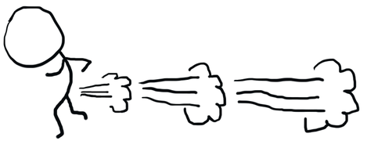
Caution
A side effect of eating ~2 ¼ lbs of beans
Even vegetarians!

Slide 33
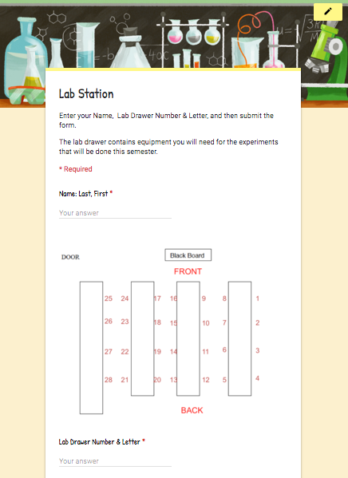
Lab Drawer Check Out
The lab drawer contains equipment you will need for the experiments that will be done this semester.
Using a smart phone or a laptop:
Connect to the Internet.
Go to:
https://goo.gl/forms/9JczWUgwvujtWekJ2
Enter your Name, Lab Drawer Number & Letter, and then submit the form.

Slide 34
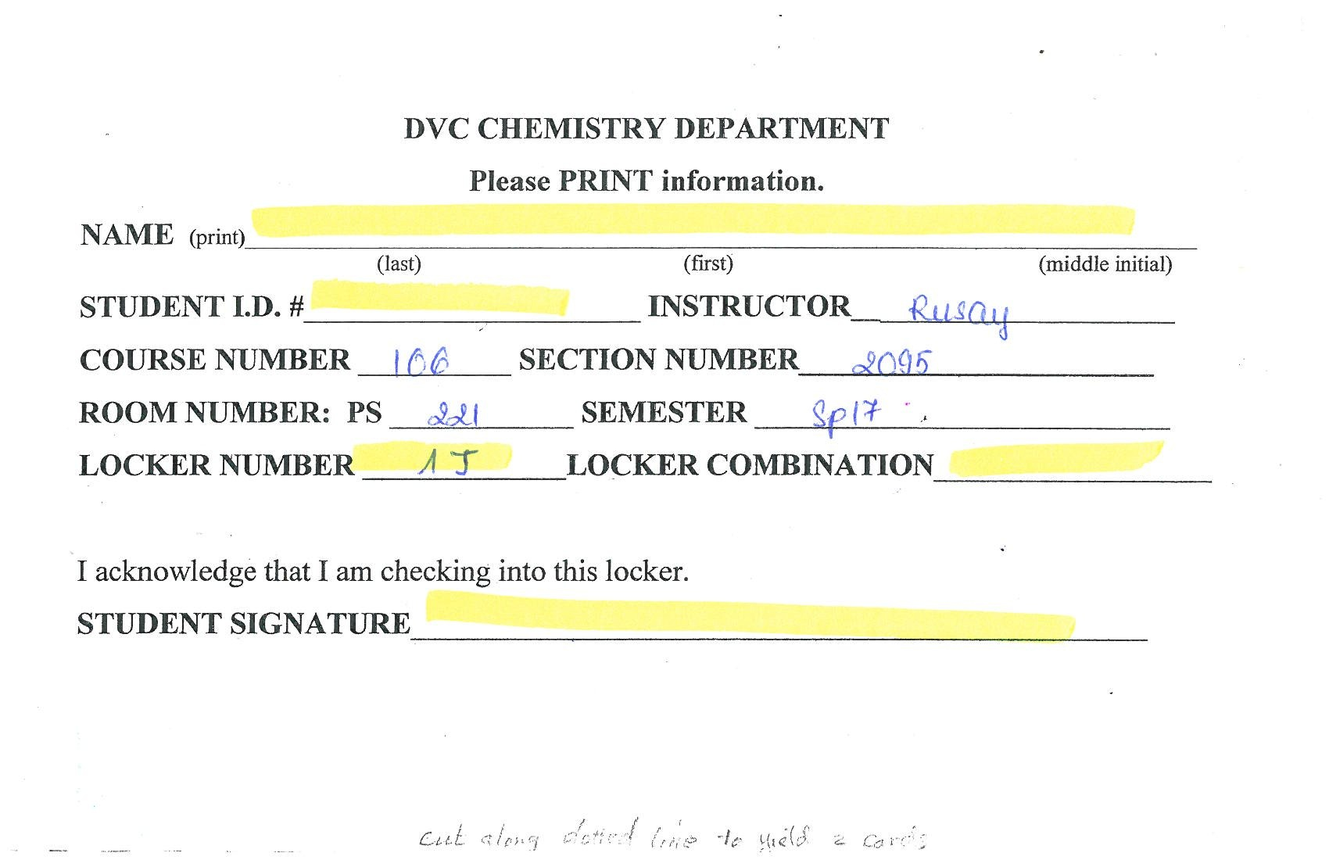
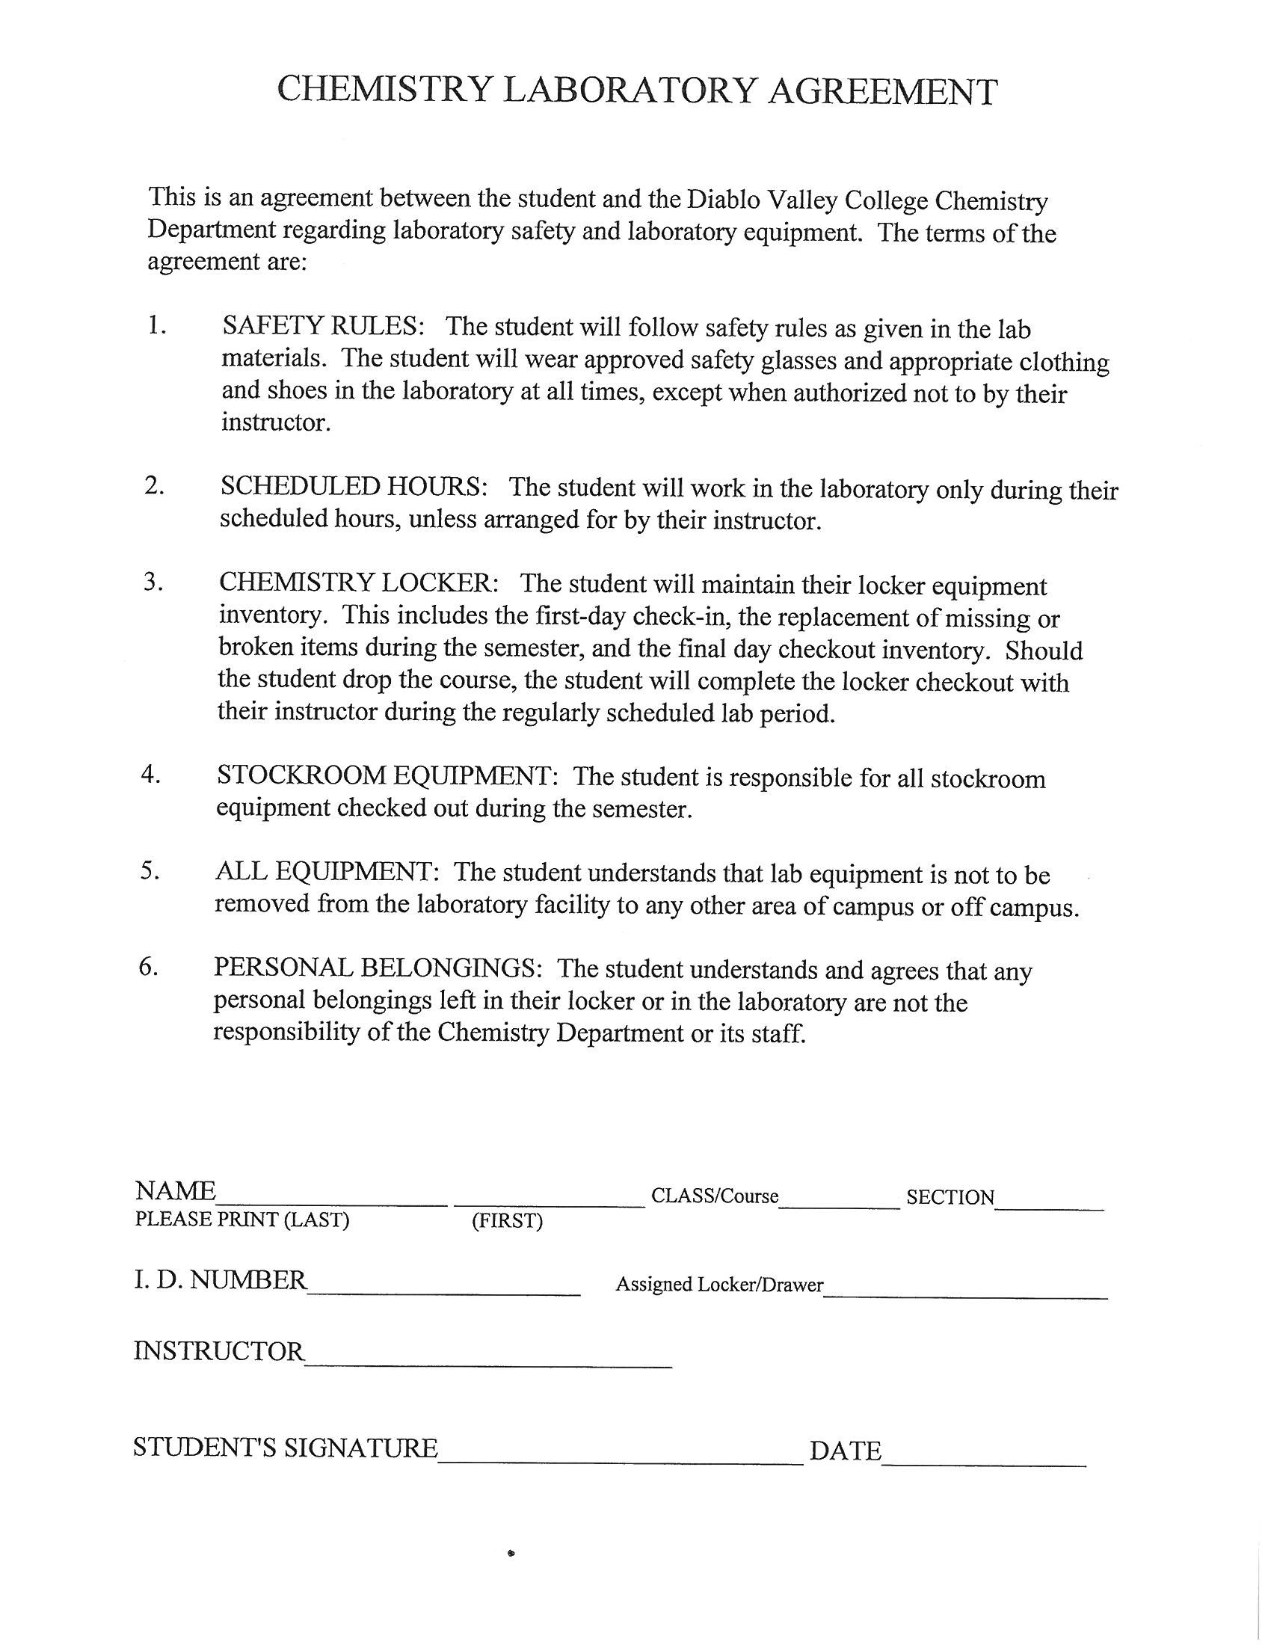
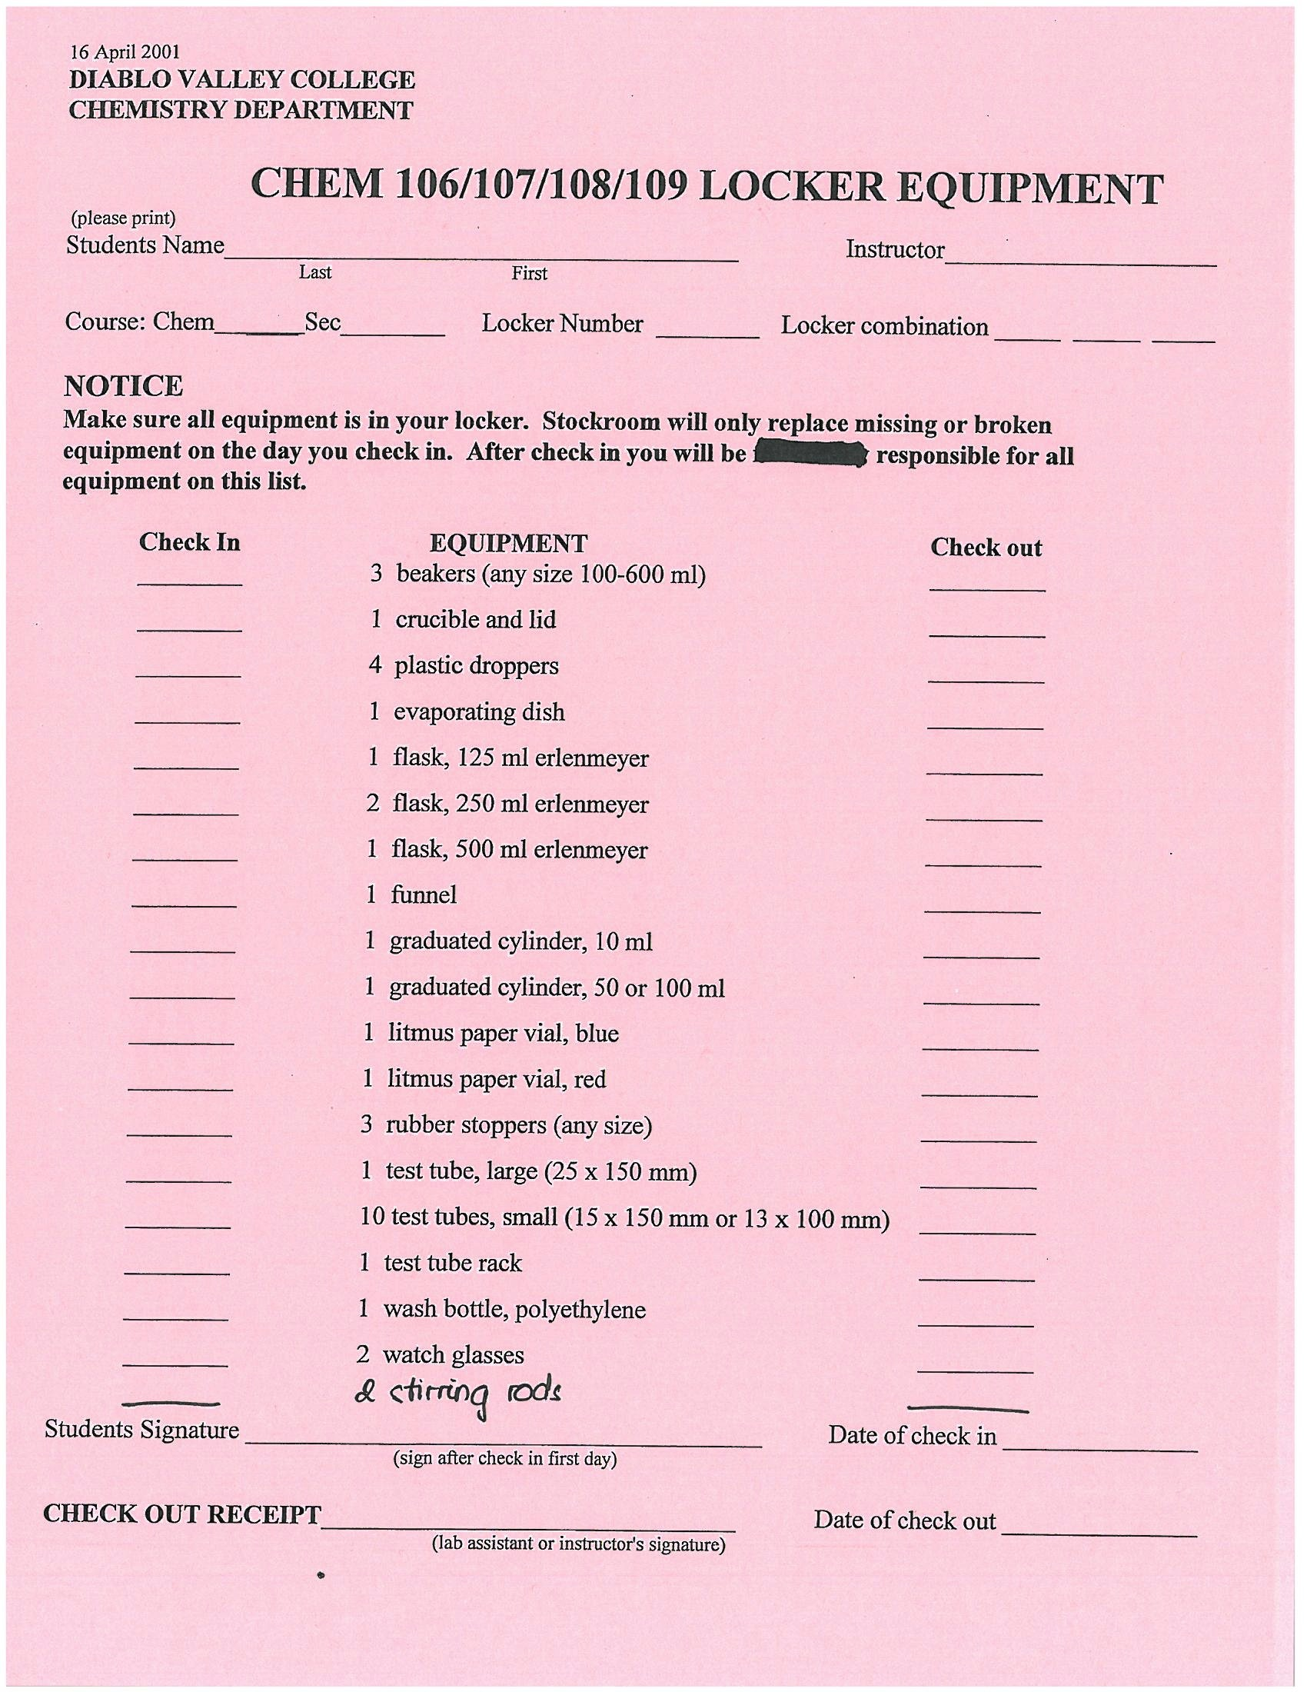
Lab Drawer Check Out
Pick up a combination lock at the front of lab.
Everyone must separately provide all of the information in each of the following 3 forms, sign and turn them in before leaving lab today.
Write down the lock’s combination where you can find it; bring to lab next week
Check that all of the equipment on the list is in the drawer and unbroken.
Read carefully & sign

Slide 35
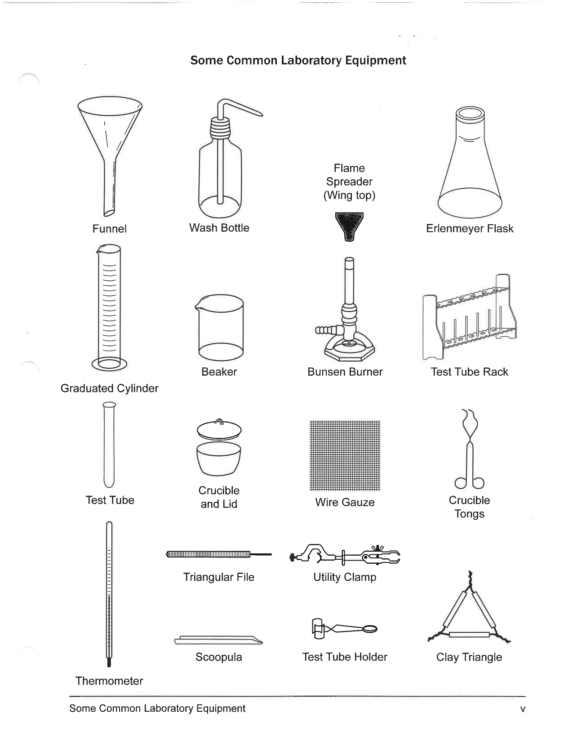
Check Out
On the pink form note what is missing or broken. If everything is OK, sign form, note combination for your use, turn in with completed/ signed acknowledgment form and card to Dr. R.
If anything is missing or broken, take the pink form to the Chemistry Stockroom. Directions on next slide.

Slide 36

Missing or Broken Equipment
Go to stockroom window to replace missing or broken equipment.
Stockroom window is in the middle of this building. Turn right out of lab, walk past 2 lab rooms and look for the double glass doors.
Window is in the back.
Double doors with window & counter set back
X
Stockroom Window
You are here
X
When everything is OK, sign form, note combination for your use, turn in with completed/ signed acknowledgment form and card to Dr. R.

